Slide 1
Peninsula Hotel Group – Presentation of Market Segment and Cancellations
Date: February 28, 2024
Presenter: Patricia Dros

Slide 2
The Peninsula IHG would like to monetize their cancellations and increase their bookings via the online market segment.
!
The two criteria for a customer choosing a hotel is accommodation and cuisine. I evaluated the hotel venues, meal type, room accommodation, and bookings by month.
The first undertaking is to understand our customer and their preferences – this is where we generate money.
!
Review the financials and the effect of online cancellations.
Of the available data, I evaluated our cancellations by market segment, lead time and deposit type.
!
As I analysed our customer and our financials, it became impossible to ignore that the data provided is giving false results
I compared the raw data set I was given to the data after I cleaned it. I also evaluated the ranges for lead time, wait list and ADR.

Slide 3
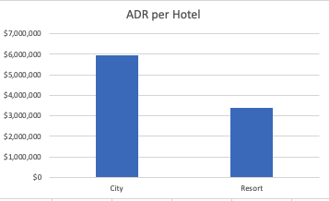
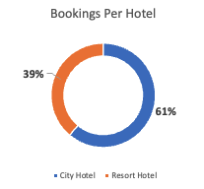
Our City Hotel, based on the bookings and revenue, is not doing better than the Resort Hotel.
Key Insights
Overarching Insight – City Hotel is is performing better than the Resort Hotel.
Support Point 1
Looking at our total bookings and the percentages, City Hotel gets more bookings
Support Point 2
The ADR indicates the same
Support Point 3
On the following slide, our trend line tells us that online cancellations for City Hotel is on the decline.

Slide 4
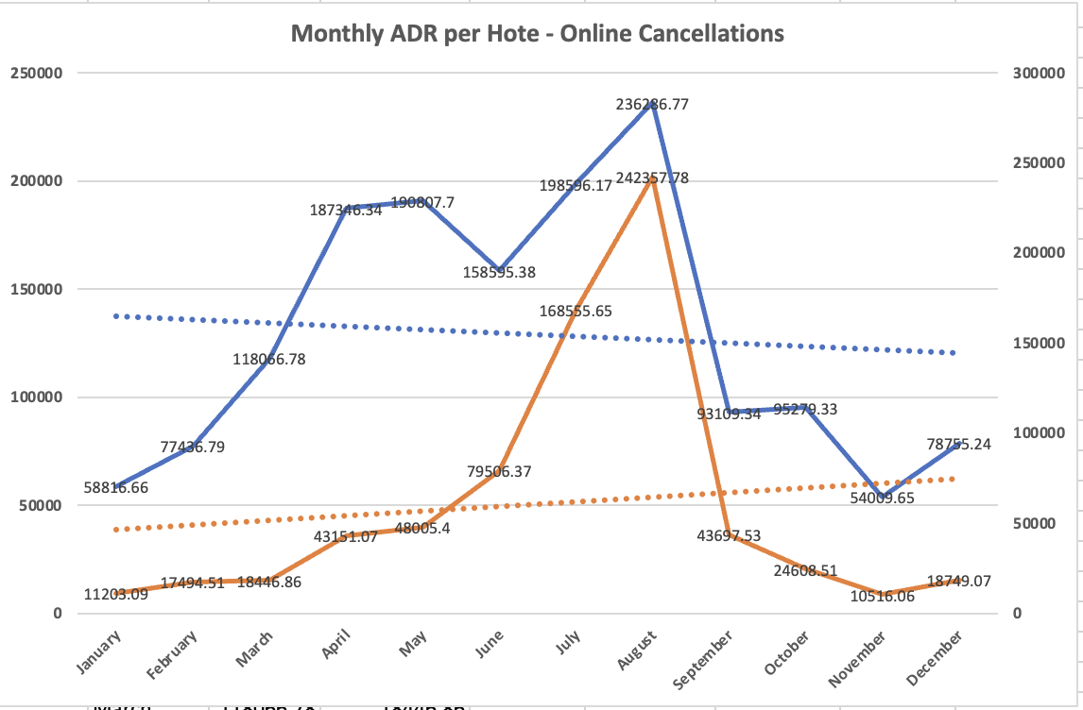
Our City Hotel, based on the bookings and revenue, is not doing better than the Resort Hotel.

Slide 5
The basis for this presentation is to review our cancellations and online market segment in order to make recommendations.
Through this analysis I am going to provide strategies to monetize cancellations and increase online bookings by 4%. At least one strategy for monetization and one for online booking should take place in the next 6 months. These actions tie back to the initial challenge.
View bookings over time and the average daily rate.
Correlate variables identified in executive presentation to online cancellations.

Slide 6
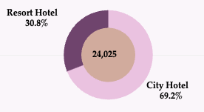
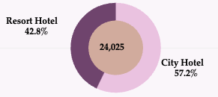
There is a linear relationship between direct bookings and cancellations. Whereas the relationship between online bookings and cancellations is affected by seasons.
Percent of Total Online Cancellations per Hotel
Key Insights
Total Cancellations account for 27% of booking total.
City Hotel online cancellations are more than twice of Resort Hotel
Direct cancellations have a more even spread, not such a broader range.
The next slide shows some insight to explain this disparity.
Direct total bookings are less than online and are steady throughout the year, so then will cancellations. Vice versa for Online bookings.
However, there is a sizeable increase in bookings, and hence cancellations, for the winter months. This will affect overall totals.
Percent of Total Direct Cancellations per Hotel

Slide 7
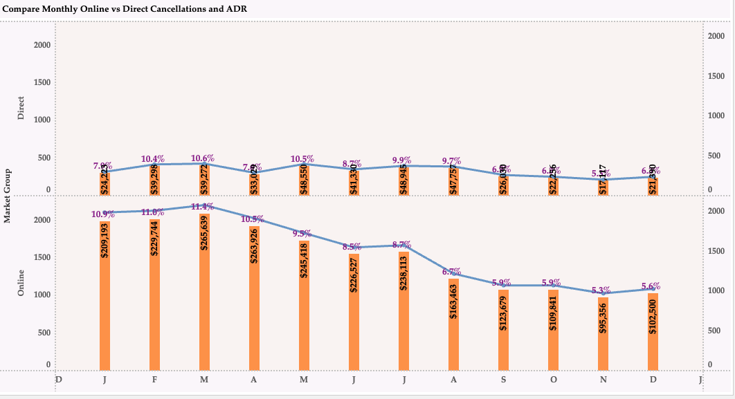
The relationships between direct and online booking channels and cancellations

Slide 8
We need better data to understand why our customers are cancelling.
Key Insights
After reviewing correlating factors, the trend for guests least likely to cancel are:
Repeated Guests, makes sense otherwise they wouldn’t come back.
Those that have previously booked and not canceled
Those assigned to a room, that was surprising. I figured they’d be unhappy because not getting what they expected
Guests that make booking changes, perhaps they like the flexibility.
On the next two slides we will see visuals that will demonstrate the profiles of guests that are LESS likely to cancel and those MORE likely to cancel.
(All the variables in the given data are considered)

Slide 9
Criteria of guests that are less likely to cancel per hotel
The guests least likely to cancel is:
Booking changes made by our guests prior to check-in. Our guests enjoy the freedom to make changes as needed.
Guests that have previously booked and not cancelled. Guests that repeat business is a great indicator of our hotels success for overall satisfaction of our guests.
Repeated guests, again the success of our overall satisfaction.
Note that each of these variables contribute to a total of 5,200 guest cancellations.

Slide 10
Criteria of guests that are more likely to cancel
The guests most likely to cancel is:
Deposit type, over 95% of guests that book do not put down a deposit.
Guests that have previously cancelled are likely to cancel again.
It seems no matter which channel our guests use to book the hotel, overall, they are more likely to cancel.
Our meal full board (3 meals per day) and half board (2 meals per day) meal type are doing quite poorly for a hotel especially considering next to room accommodation, this is very important to guests choosing a hotel.
Finally, the longer guests wait from the time of booking to the time of check-in the higher the possibility of them cancelling
The takeaway here that the highest tick mark shows approximately 80,000 guest cancellations for the City Hotel.
The combined result of both hotels yields approximately 120,000 cancellations.
Note, for this chart we are counting not summing so the results will be an even spread. What’s important is the result number of cancellations.

